Slide 1
FALL DETECTION
GROUP-H2
GROUP LEADER:-M KUSHAGRA
MEMBERS:-ASHUTOSH KHARE
KUNAL MANNA
RUSHA MONDAL
SHUBHAM TYAGI

Slide 2
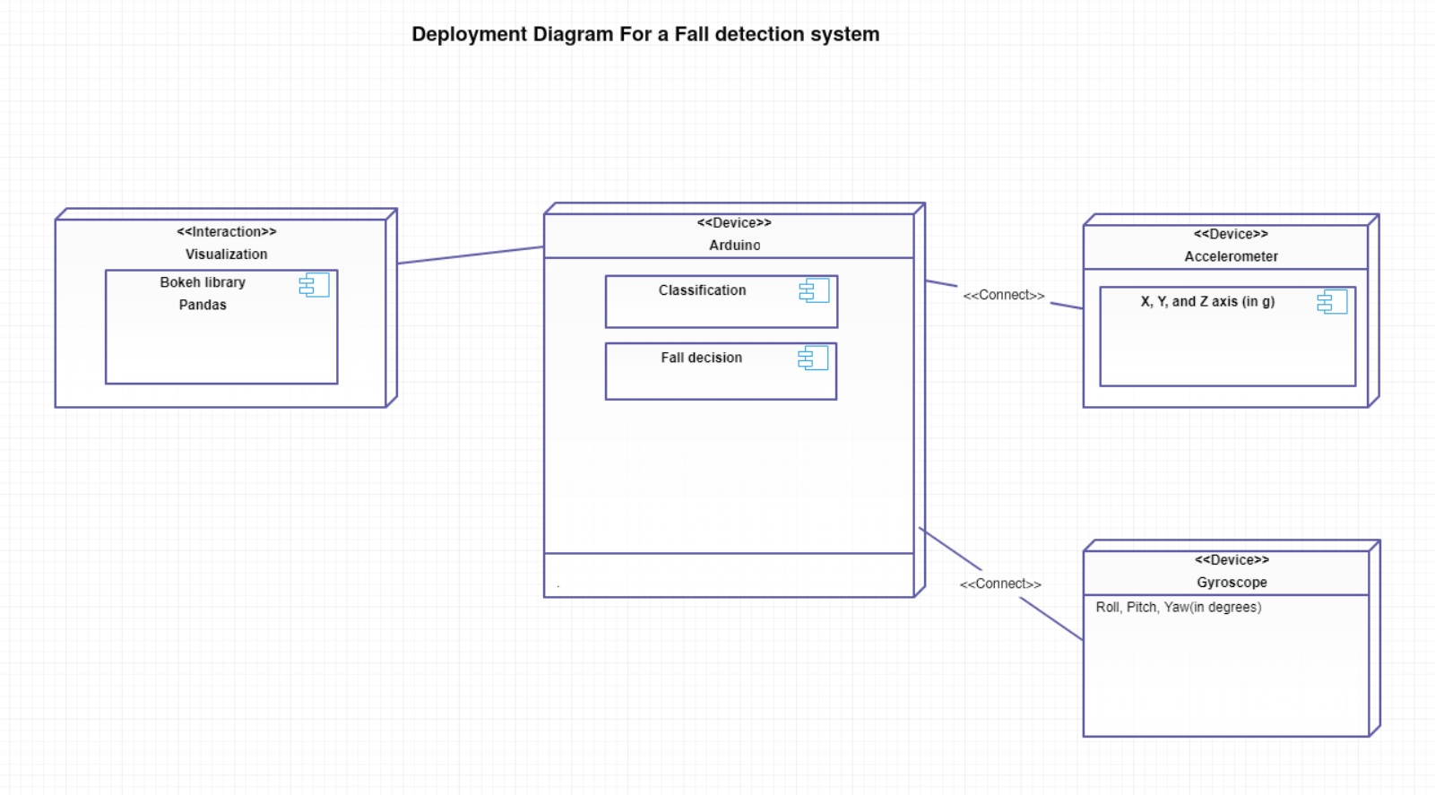

Slide 3
BLOCK DIAGRAM
Accelerometer
Gyroscope
Processing
Classification
Visualisation

Slide 4
PACKAGE – FALL_DETECTION
NODES
accelerometer
gyroscope
Processing
Classification of falls
Visualization (bokeh)

Slide 5
Topics -
read_a
read_g
threshold
classify
decision
Message –
aX,aY,aZ(coordinates)
gX,gY,gZ
magnitde_a
magnitude_g
fall_type

Slide 6
THANK YOU!

